Slide 1
2024 Bayesian Modelling Workshop
Seungjae Lee
Department of Civil & Mineral Engineering
University of Toronto
July 30, 2024

Slide 2
Workshop Outline
Measurement uncertainty and Bayesian estimation
Bayesian linear regression
Latent/unobservable variables
Advanced Topics (if time allows):
Gaussian process regression
Bayesian optimization
Probabilistic deep learning

Slide 3
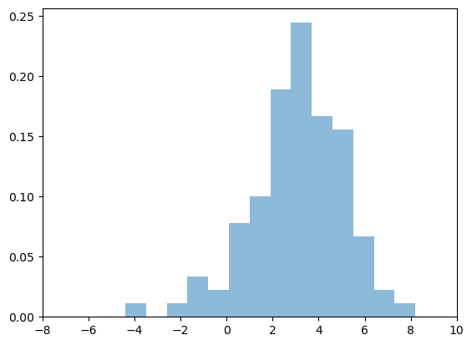
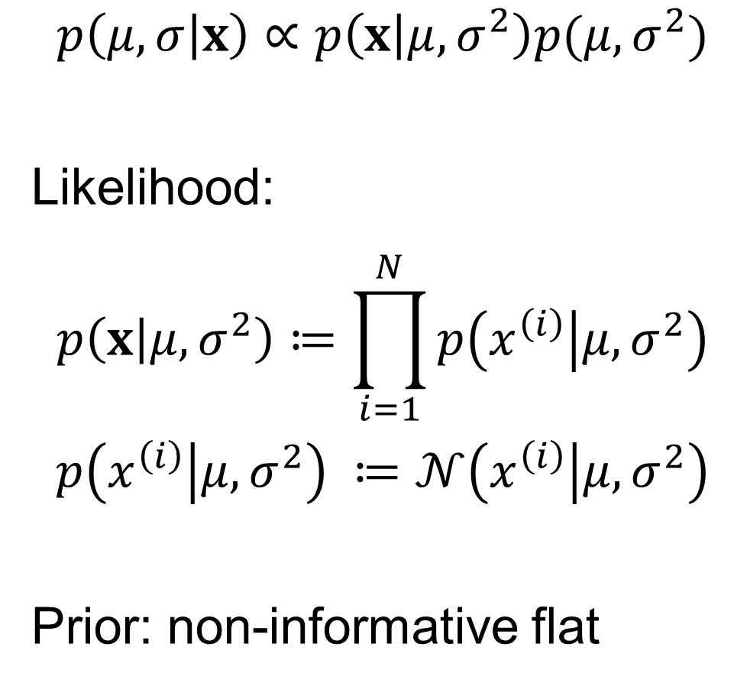
Gaussian Distribution
$$p\left(μ,σ | x\right)∝p\left(x | μ,σ^{2}\right)p(μ,σ^{2})$$
Likelihood:
$$p\left(x | μ,σ^{2}\right)≔\prod_{i=1}^{N}{p\left(x^{\left(i\right)} | μ,σ^{2}\right)}$$
$$p\left(x^{\left(i\right)} | μ,σ^{2}\right) ≔𝒩\left(x^{\left(i\right)} | μ,σ^{2}\right)$$
Prior: non-informative flat

Slide 4
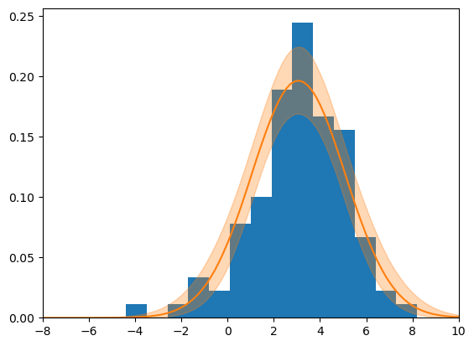
Gaussian Distribution

Slide 5
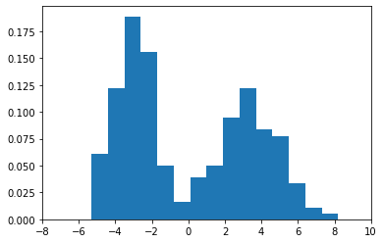
Gaussian Distribution

Slide 6
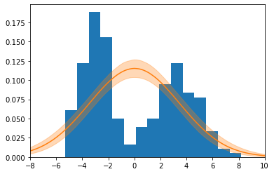
Gaussian Distribution

Slide 7
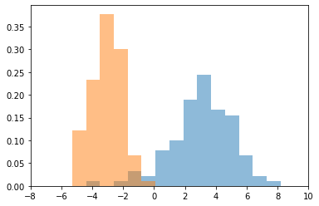
Gaussian Distribution
Notes:
$$𝒩\left(x_{1} | μ_{1},σ_{1}^{2}\right)$$
$$𝒩\left(x_{2} | μ_{2},σ_{2}^{2}\right)$$

Slide 8
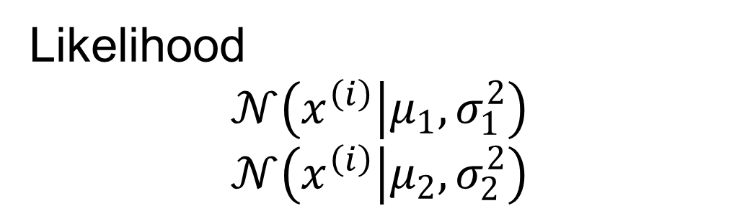
Gaussian Distribution
$$p\left(μ_{1},σ_{1},μ_{2},σ_{2} | x_{1},x_{2}\right)∝p\left(x_{1} | μ_{1},σ_{1}\right)p\left(x_{2} | μ_{2},σ_{2}\right)p(μ_{1},σ_{1},μ_{2},σ_{2})$$
Likelihood
$$𝒩\left(x^{\left(i\right)} | μ_{1},σ_{1}^{2}\right)$$
$$𝒩\left(x^{\left(i\right)} | μ_{2},σ_{2}^{2}\right)$$
Notes:
$$𝒩\left(x_{1} | μ_{1},σ_{1}^{2}\right)$$
$$𝒩\left(x_{2} | μ_{2},σ_{2}^{2}\right)$$

Slide 9
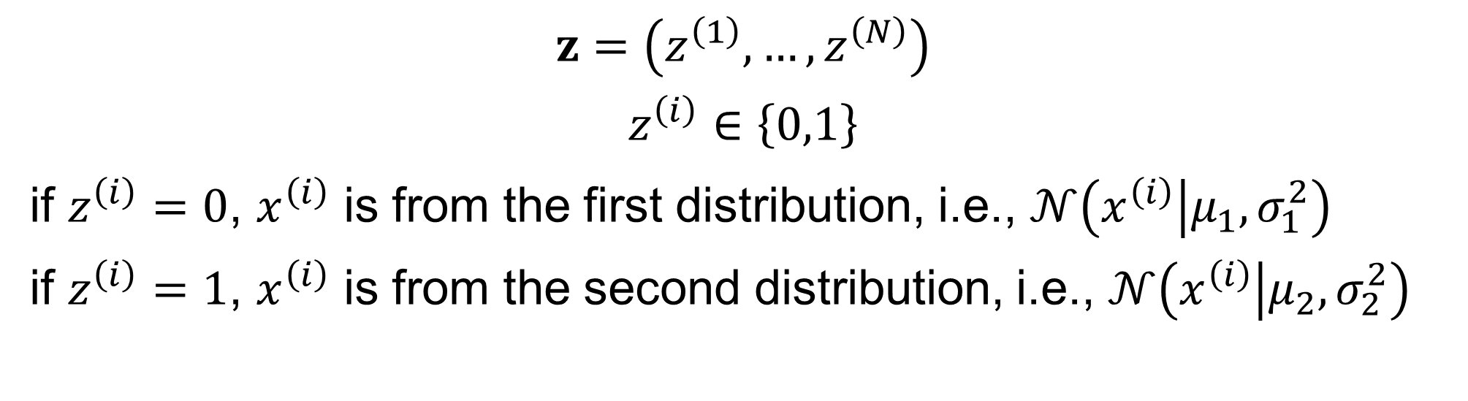
Gaussian Mixture
$$z=\left(z^{\left(1\right)},…,z^{\left(N\right)}\right)$$
$$z^{\left(i\right)}∈\left\{0,1\right\}$$
if $z^{\left(i\right)}=0$, $x^{\left(i\right)}$ is from the first distribution, i.e., $𝒩\left(x^{\left(i\right)} | μ_{1},σ_{1}^{2}\right)$
if $z^{\left(i\right)}=1$, $x^{\left(i\right)}$ is from the second distribution, i.e., $𝒩\left(x^{\left(i\right)} | μ_{2},σ_{2}^{2}\right)$
$$p\left(μ_{1},σ_{1},μ_{2},σ_{2},z | x\right)∝p\left(x | z,μ_{1},σ_{1},μ_{2},σ_{2}\right)p(z,μ_{1},σ_{1},μ_{2},σ_{2})$$

Slide 10
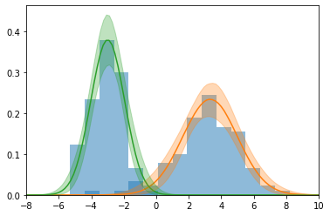
Gaussian Mixture

Slide 11
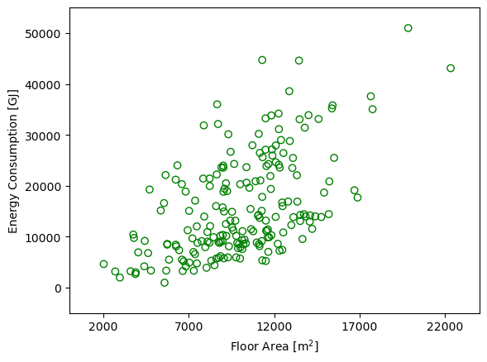
Mixture of Linear Models

Slide 12
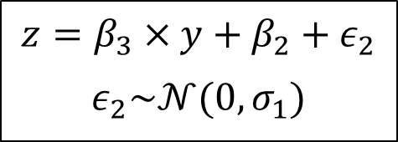
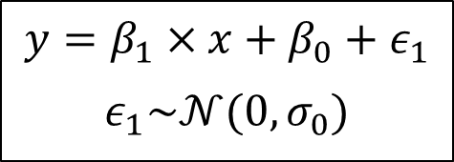
Another Example – Missing Data
x
y
z
$$y=β_{1}×x+β_{0}+ε_{1}$$
$$ε_{1}\sim 𝒩(0,σ_{0})$$
$$z=β_{3}×y+β_{2}+ε_{2}$$
$$ε_{2}\sim 𝒩(0,σ_{1})$$

Slide 13
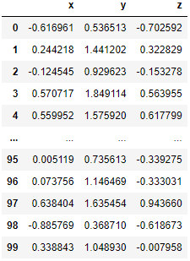
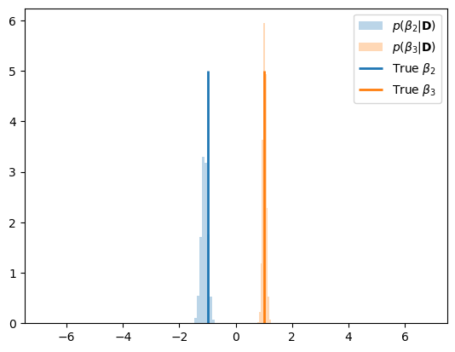
Another Example – Missing Data
x
y
z

Slide 14
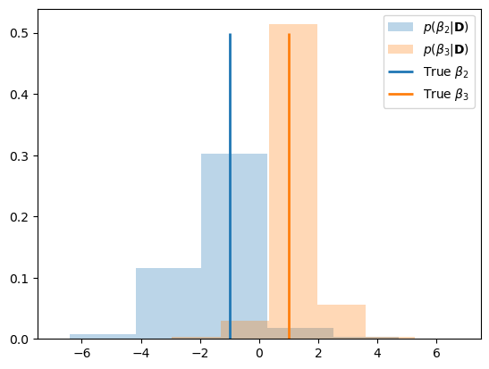
Another Example – Missing Data
x
y
z
NA

Slide 15
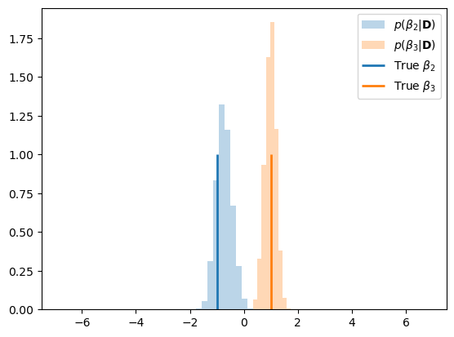
Another Example – Missing Data
x
y
z
NA

Slide 16
Exercise

Slide 17
Thank you
Seungjae Lee
sjae.lee@utoronto.ca

